Slide 1
Easter 2023 Shopping in Canada Survey | National Consumer Research – Caddle & RCC
This year, more than 87% of Canadians who celebrate Easter plan to make either the same or more purchases compared to last year.

Slide 2
Caddle, in partnership with the Retail Council of Canada (RCC), surveyed Canadians from coast to coast to better understand consumers’ shopping intentions around Easter.
Surveys were conducted in March 2023 using Caddle’s mobile platform and online panel amongst a representative randomized sample of n= 9,803 and n= 10,396 Canadian adults.
All data presented is owned by Caddle and has a Margin of Error of 1% or lower. The survey was self-commissioned and paid for by Caddle, Inc.

Slide 4
Key Findings on Easter
Where Are Canadians Shopping for Easter?
Food and Beverage retailers narrowly edge Big Box retailers to take the largest share (around 47%) of Canadian’s wallets on Easter
Who Celebrates Easter?
Almost two-thirds (66)% of Canadians celebrate Easter
How Many Make Purchases for Easter?
This year, more than 87% of Canadians who celebrate Easter, plan to spend the same or more as compared to last year
What Are Canadians Buying for Easter?
Food, Alcohol, Candies Restaurants, etc. are the top spending category for Easter
How Much are Canadians Spending on Easter? More than 54% of Canadians who celebrate Easter, spend more than $50

Slide 5
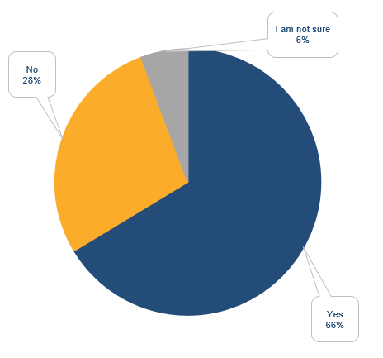
Do you normally celebrate Easter?
66% of Canadians plan to celebrate Easter in 2023, versus 67.3% in 2022
Not a massive shift in the trend of Canadians that plan to celebrate Easter this year compared to last year.
Caddle Daily Survey March, 2023 | n =9,803

Slide 6
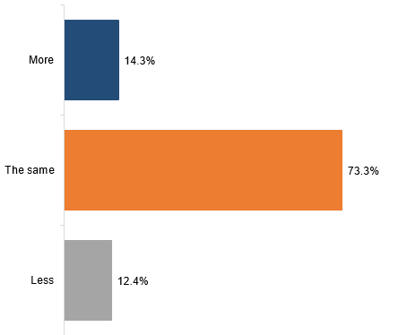
Would you expect to spend more or less on Easter this year compared to last year?
This year, more than 87% of Canadians who celebrate Easter, plan to spend the same or more as compared to last year.
73.3 % of Canadians expect to spend the same amount of money on celebrating Easter as they did last year
The number of people who were ready to increase their spending as compared to last year has decreased by 1% (14.3% this year vs 15.3% last year)
A probable reason is the spending squeeze due to increased inflation which has caused people to tighten their purse strings.
Caddle Daily Survey | March, 2023 | n = 7,063

Slide 7
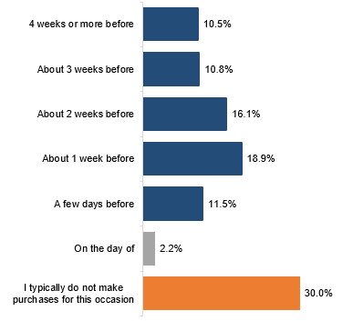
This year, 70% of Canadians plan to make purchases related to Easter, in 2022 this number was 73.7%
How far in advance do you make purchases related to Easter?
The largest group (18.9%) makes purchases about 1 week prior to the holiday
The 2nd largest group (16.1%) makes purchases 2 weeks prior to the holiday
More than 56% of Canadians will plan at least a week before Easter to make purchases
The percentage of people planning two weeks or more in advance has decreased. People are being more watchful and planning their purchases closer to the holiday.
Caddle Daily Survey | March, 2023 | n = 10,396

Slide 8
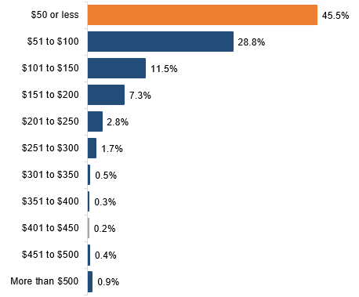
How much do you normally spend in total for Easter?
Over 54% of Canadians who celebrate Easter, spend more than $50
45.5 % of Canadians spend $50 or less on Easter
This is followed by 29% of Canadians spending between $51-$100, and 11.5% spending between $101-$150 on Easter
Caddle Daily Survey | March, 2023 | n = 7,063

Slide 9
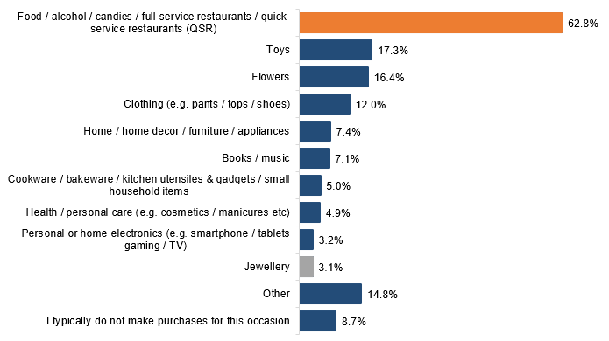
Food/ Alcohol/ Candies/ Restaurants etc., is the top spending category for Easter, as was in 2022
For those celebrating Easter, top spending categories include Food/alcohol/candies/restaurants (62.8%), and next is Toys, Flowers, Clothing, and Home /Home Décor / Furniture/ Appliances (53%).
Which of the following do you spend money on as gifts or as items specifically associated with Easter
Caddle Daily Survey | March, 2023 | n = 7,063

Slide 10
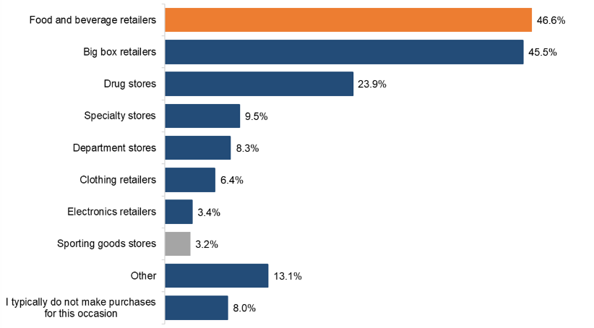
Food and Beverage retailers narrowly edge Big Box retailers to take the biggest share of Canadian’s wallets on Easter
For those celebrating Easter, the top three retail categories shopped are Food and Beverage retailers, (46.6%), Big Box retailers (45.5%), and Drug Stores (23.4%). The top three ranking remains unchanged as compared to 2022
Which of the following stores do you normally make purchases related to Easter?
Caddle Daily Survey | March, 2023 | n = 7,063

Slide 11
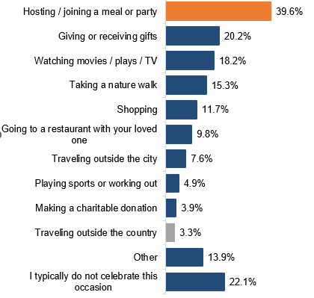
This year, around 40% of Canadians will be Hosting / Joining a meal or Party on Easter
The top three activities Canadians normally do during Easter include Hosting / Joining a meal or Party (39.6%) Giving or Receiving Gifts (20.2%), and Watching movies / plays / TV (18.2%)
Which of the following do you normally do during Easter?
Caddle Daily Survey | March, 2023 | n = 10,396

Slide 12
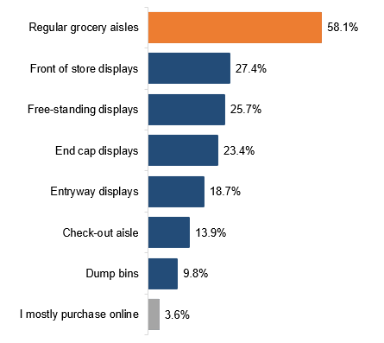
Where in the store do you normally purchase the items for Easter?
The majority of Canadians search for Easter products in the grocery aisles
58.1% of Canadians purchase Easter products in the regular grocery aisles. This has gone up by 18% compared to 2022.
This is followed by Front of store displays (27%), and Free Standing displays (26%)
3.6% of Canadians purchase something for Easter online
Caddle Daily Survey l March 2023 | n = 7,279

Slide 13
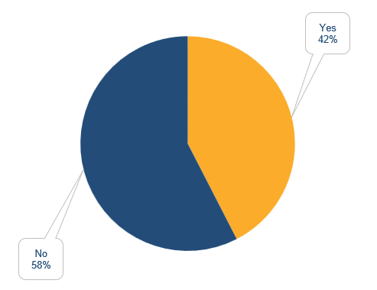
42% of Canadians make dedicated trips for Easter shopping
Do you normally make a dedicated trip to buy things for Easter?
Compared to last year, 46.6% Canadians didn’t plan a dedicated trip for Easter shopping
This year slightly more (10-11%) Canadians will tack on Easter items to an existing shopping trip compared to last year.
Caddle Daily Survey | March, 2023 | n = 7,279

Slide 14
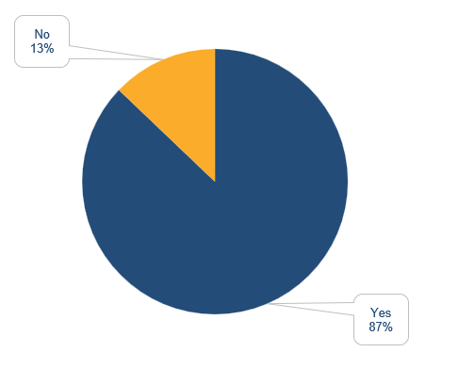
Would you prefer to shop locally in person instead of online this year for Easter?
87 % of Canadians will shop locally in-person this Easter
Last year, 60% of Canadians planned to shop locally in-person. Significantly more Canadians are looking to shop in-person, a post-COVID trend for retailers
It can be infered that consumers are looking for an in-person shopping experience
Caddle Daily Survey | March, 2023 | n = 7,279

Slide 15
Anuj Punni
anuj.punni@caddle.ca
www.askcaddle.com

